Slide 1
Our Project Presentation
General Audience
Notes:
Tips:
Identify your audience and speak to their interests specifically. Adapt your message and your slides to to suit them.
Start with a high-level, concise, clear overview of your project.
Avoid unfamiliar jargon.
Be explicit about what you’re asking of your audience.
Show visual examples of your project’s components as they will appear in Esploro (See the “Ex Libris Esploro Demo” and “Esploro Slide and Screenshots Library” sections at the end of this file.)

Slide 2
Introductions
Sponsors
Divisions
Core Team
Notes:
Tip:
If it’s practical, consider asking your core team and attendees to introduce themselves and what their project role is. This will help people put faces to names later.

Slide 3
Institutional Alignment
[Insert Your Mission and Vision Statements Here]
[Insert Your project outcomes]
Notes:
Tip:
Speaking the same language as your institution’s leadership will promote buy-in.
You can usually find your institution’s Mission and Vision statements on your institution’s homepage under “About.”

Slide 4
Project Overview
[Insert a short, legible overview of our project.]
Notes:
Tip:
Add short description of a couple of sentences that fit legibly on this slide.

Slide 5
Our Project’s Components
Profiles
Portal
Analytics
Notes:
Tips:
Be clear about how your components differ from and compliment other institutional initiatives or solutions.
Acknowledging the hard work of your colleagues who have contributed to previous similar initiatives will foster good will.

Slide 6
Introduce Ex Libris and Esploro. You can choose the relevant information from the “Ex Libris Esploro Slides” section below.

Slide 7
Our Project Phases
Phase One
Milestone One
Phase Two
Milestone One
Phase Three
Milestone One
Milestone Two
Milestone Two
Milestone Two
Notes:
Tip:
Providing phases and a general timeline will help you set expectations for your audience and encourage them to think of the timing of their own projects.

Slide 8
We Welcome Your Participation!
Review
Feedback
Support
Notes:
Tips:
Be clear about what you're asking of your audience.
Enthusiasm, empathy, honesty and openness help establish trust.

Slide 9
Questions & Comments
Notes:
Tip:
Record your audience’s questions and comments.
If you don’t have immediate answers, offer to find answers and follow up later.

Slide 10
Esploro: A Solution and Partnership
Notes:
For up-to-date information about Esploro see: https://exlibrisgroup.com/products/esploro-research-services-platform/

Slide 12
Esploro Research Information Hub
Portal
Showcasing researchers, publications, data sets, media mentions and more in a customizable, user-friendly portal accessible from any website or global search engine.
Profiles
Auto-generating and updating researcher profiles with publications, expertise, affiliations, awarded grants, identifiers and media mentions
Analytics
Collecting rich data and metrics for insights and benchmarks across researchers, units, and institutions, and making them available for other systems

Slide 18
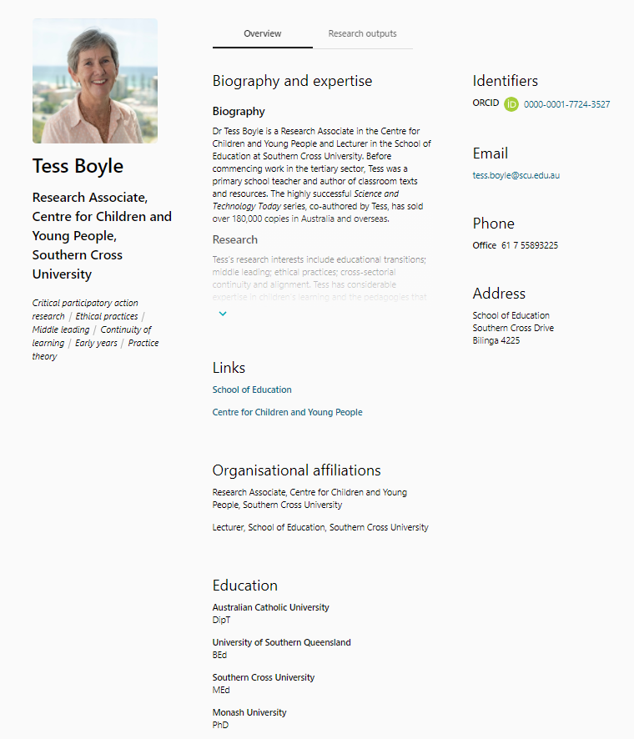
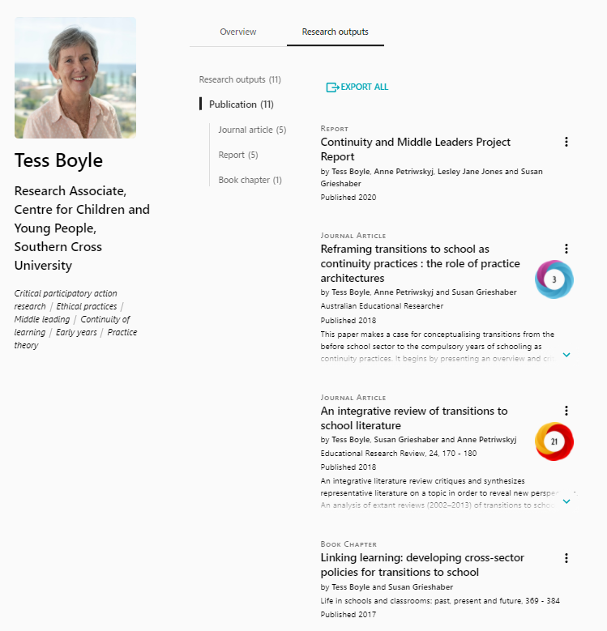
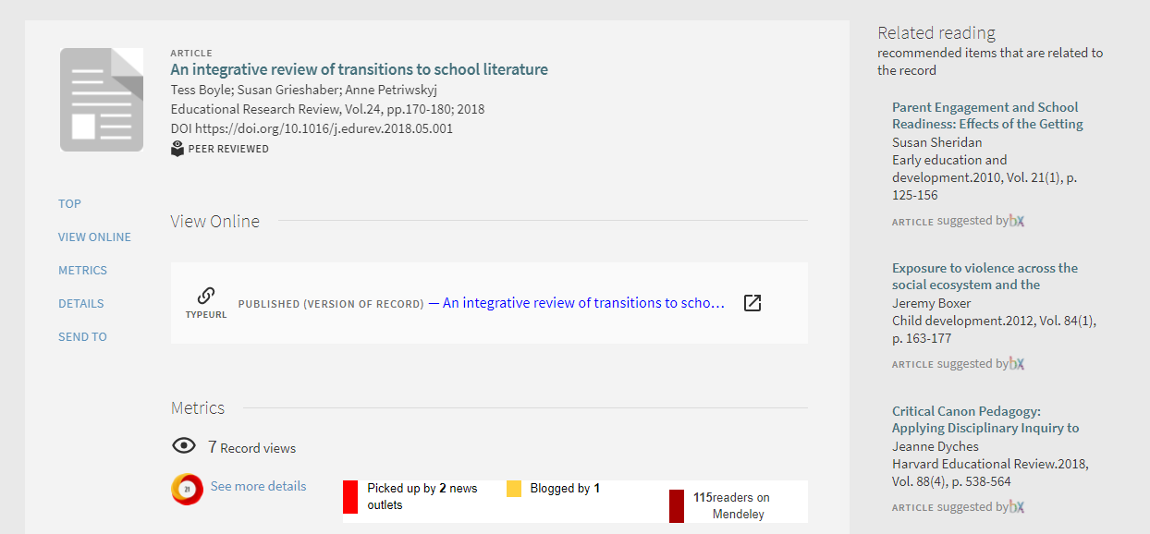
https://researchportal.scu.edu.au/esploro/profile/marie_boyle/overview?institution=61SCU_INST

Slide 19
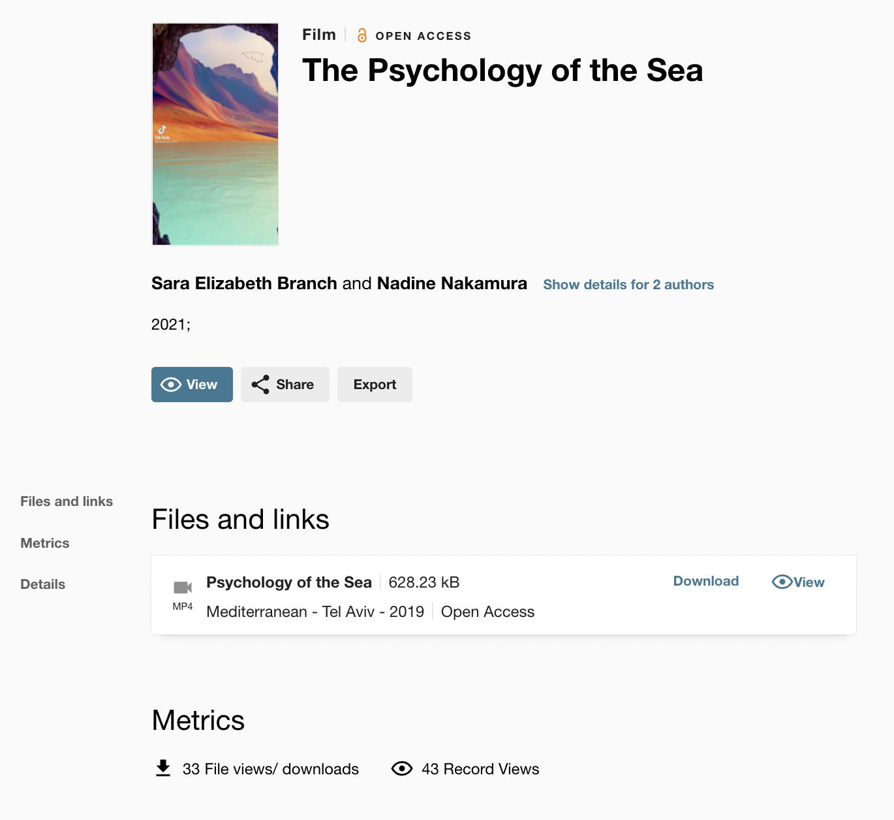
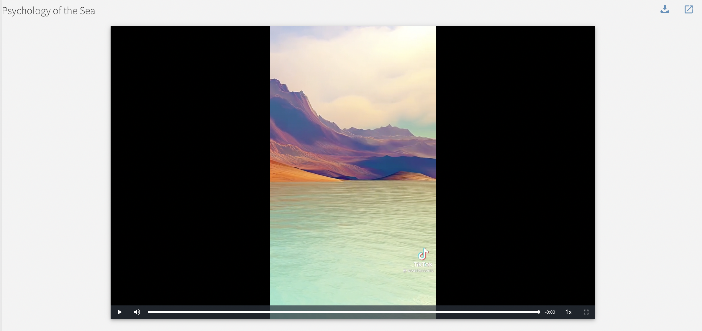
Notes:
Esploro Media Viewer

Slide 21
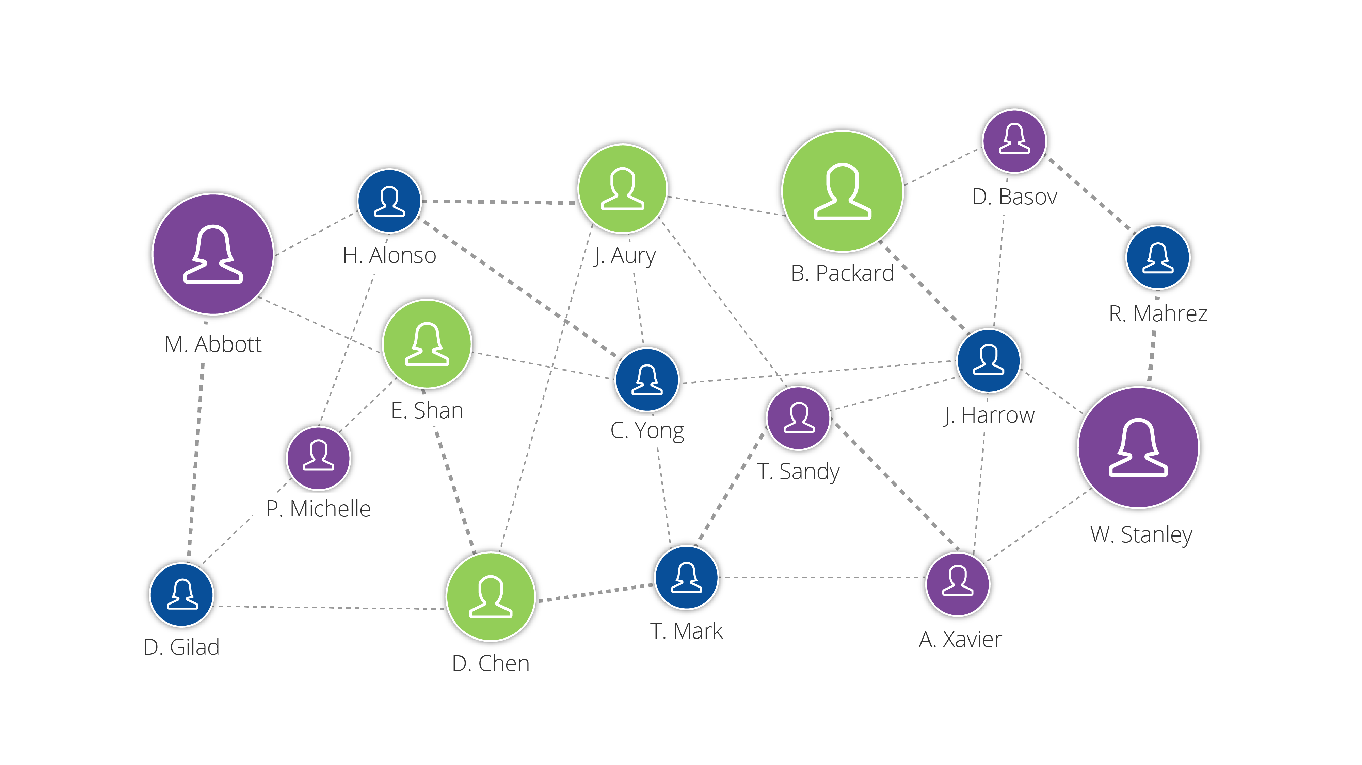
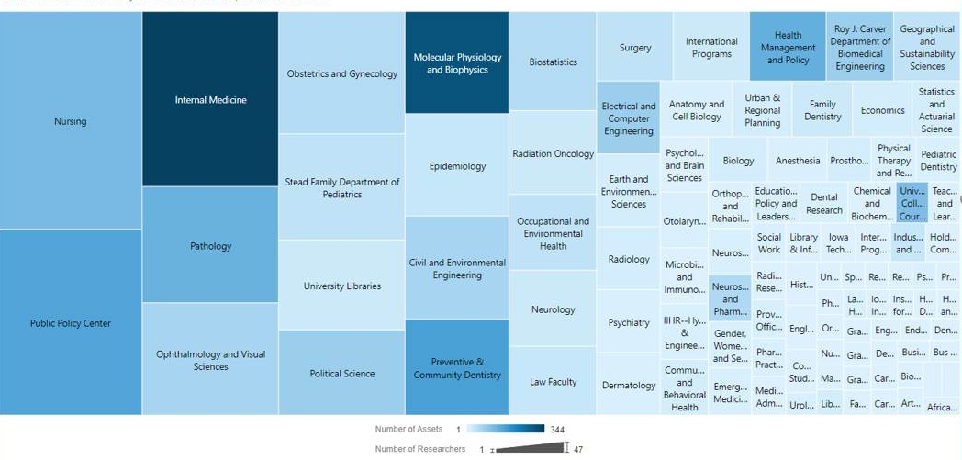
Actionable Insights: Esploro Analytics (Examples)
Research Collaboration
Researcher Influence
Who do researchers collaborate with internally and externally?
Which researchers have the most influence in a specific domain?
Academic Units Prolificity
Top Fields of Study
What are researchers working on? What output have they produced recently?
What are the main fields of study by institution, department, and researcher?
Notes:
Analytics: Esploro Insights / Question Samples

Slide 22
Esploro and ProQuest ETD Administrator
STUDENT ETD SUBMISSION
SUBMIT
Students submit their dissertation or thesis using our guided ETD Administrator workflow that assists them with the details of the process.
REVIEW
ADMINISTRATOR
ETD REVIEW AND DELIVERY
With ETD Administrator, administrators can manage their end-to-end workflow from receipt of the ETD to the delivery to their IR.
DELIVER
ESPLORO PUBLICATION
PUBLISH
ETD Admin seamlessly delivers ETD metadata and full-text PDF with supplemental files to Esploro for publication.
Notes:
ETD Admin: Workflow

